Slide 1
AMT

Slide 2
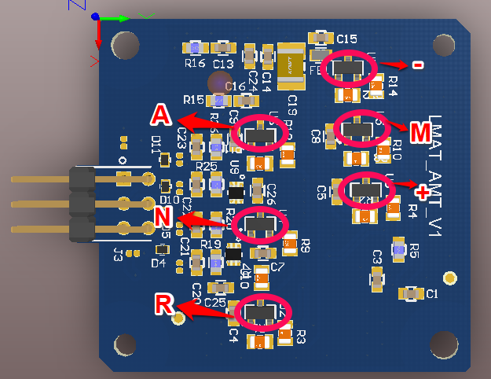
POSITIONS IN PCB

Slide 3
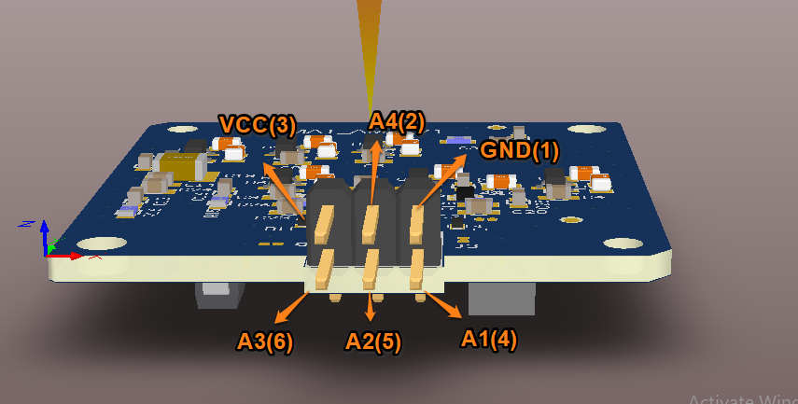
PROPOSED CONNECTOR CONNECTIONS

Slide 4
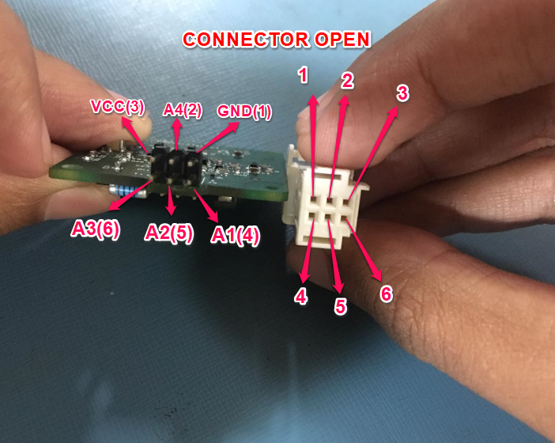
CONNECTOR OPEN

Slide 5
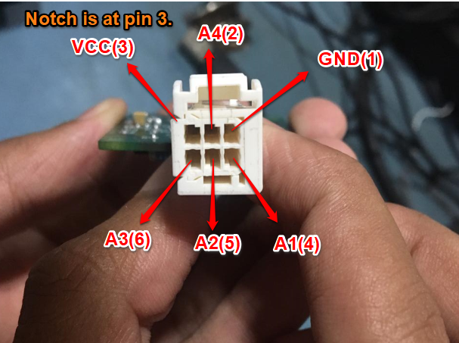
CONNECTOR CLOSED

Slide 6
THANK YOU

